Slide 1
DEH Architecture
Nidhi Zachariah Finacle ETACS

Slide 2

01
Overview
Application Architecture and Features, Deployment with DEH.
02
DEH Components
Service - REST, Transaction, Data Access, Transaction and Host integration Layers.
03
Microservices Overview
Agenda
Authentication and Authorization, Limits, Engagement, Consent.
04
Frameworks
Messaging, Caching, Open Authentication, Auditing, Monitoring, Logging and Security

Slide 3
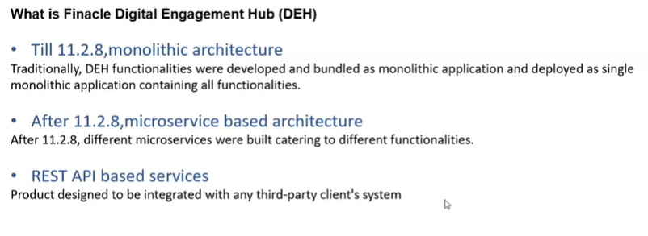

Slide 4
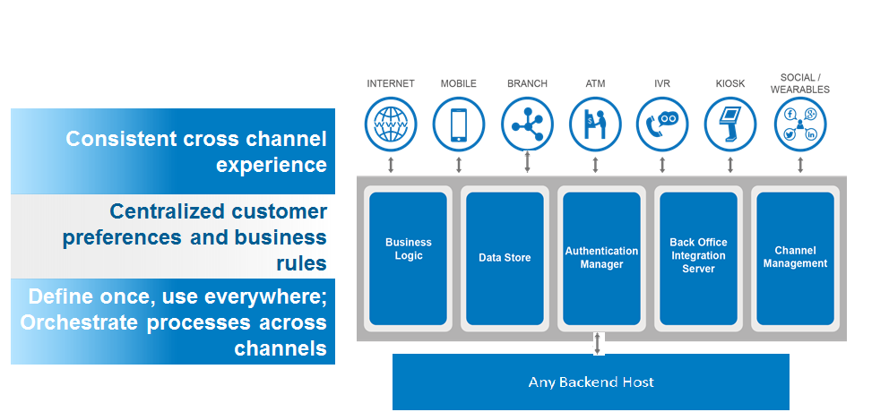
Overview

Slide 5
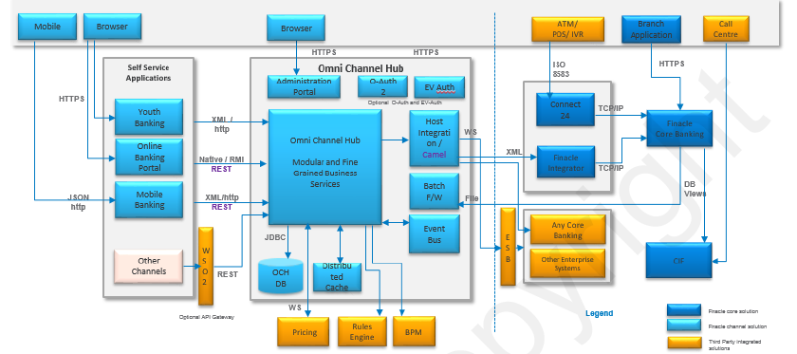
Deployment With DEH

Slide 6
Micro Services
MicroServices architecture is a method of developing applications which consists of a suite of services, which can be developed, maintained, deployed, and scaled up independent of each other.
Authentication
Limits
Authentication and Authorization capabilities are available as a micro service.
Channel limits capabilities are now available as a micro service. This includes setup for limits as well as validation and consumption of limit.

Slide 7
Service Layer – REST APIs
The Service/APIs are developed using Jersey Restful Open Source Framework(JAX_RS).
A typical API URI in DEH looks like
Retail:
{version}/banks/{bankid}/users/{userid}/{resource}.
Corporate:
{version}/banks/{bankid}/corporate/{corpid}/users/{userid}/{resource}.

Slide 8
Transaction Layer
The Service Layer(REST APIs Resource) hooks onto the business fulfilment component called transaction layer. This is the Business tier of DEH
Patterns are available across use cases of DEH.
Performs the actions such as
Life cycle management of resources like DB connection
Identifies the type of transaction (inquiry/update)
Initiates the transaction commit boundary for update type
Calls the specific implementation class

Slide 9
Transaction Layer - Patterns
This Transaction layer interacts with Host integration layer for invoking request to any backend host systems.
This layer also interacts with Data access layer in order to perform DB operations with DEH DB.
Local Database Inquiry – fetching a single record.
Local Database Inquiry – fetching a list of records.
Local Database Update
Host Inquiry - fetching single record from host.
Host Inquiry - fetching list of records from host.
Host update

Slide 10
Data Access Layer
For Query execution and data manipulation.
Wrapper classes for connection management.
Under wrappers, connection with database is through the data sources and connection pools.
Provide Debugging Info.
DML Operations are performed in DEH using Objects such as
Table Access Object (TAO)
Table Maintenance Object (TMO)
Data Access Layer (DAL)

Slide 11
Table Access Object
TAO is used in scenarios where
Operations are based on a single table, joins not required.
Operations are based on primary key
Generated from table specification (tspc) file
The below objects are generated
TAO : Table Access Object - CRUD
DAO : Data Access Object – Interface with DB
Info : Information Object – POJO Complete data
Info Key : Information Key Object – POJO Primary Key Info

Slide 12
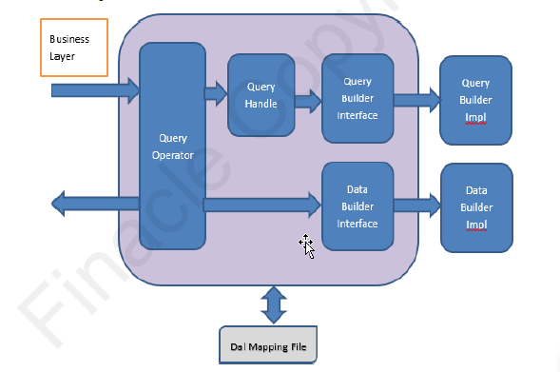
Data Access Layer (DAL)
DAL Framework is meant for Criteria based queries.
When we query the database, there are usually two steps associated with it
Building query with specific criteria.
Building data with the results obtained after query execution.
In DAL, this is broken into 2 files.
IFEBAQuery → will do query building.
IFEBADataBuilder → will do data building.

Slide 13
Host Interface Layer
“Internal Middleware” of DEH.
Integration with Apache Camel also supported.
Features:
Can be integrated with multiple external systems
Supports different protocols and message formats
Offline handling
Configured Repository
HIF Orchestrator
Protocol Handlers
Request Processors
Transformers
Host Adaptor
However it is not indented to replace middleware products

Slide 14
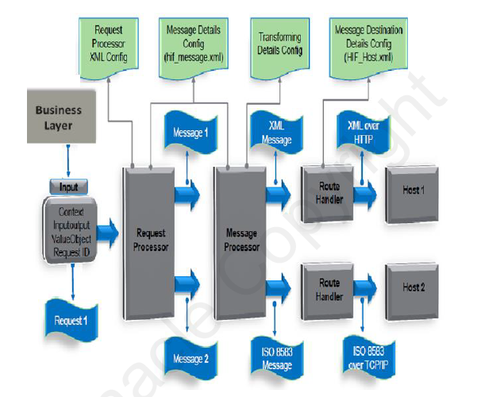
Logical Flow in HIF

Slide 15
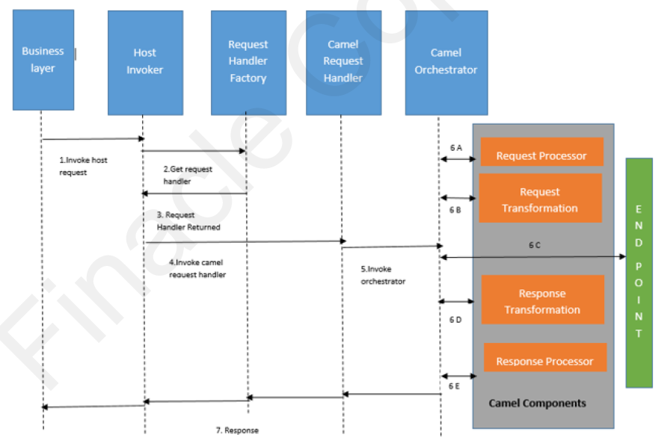
Apache Camel
Apache Camel can also be leveraged for implementing host requests.
Apache Camel is open source JAVA framework.
Focuses on making integration easier and more accessible to developers.

Slide 16
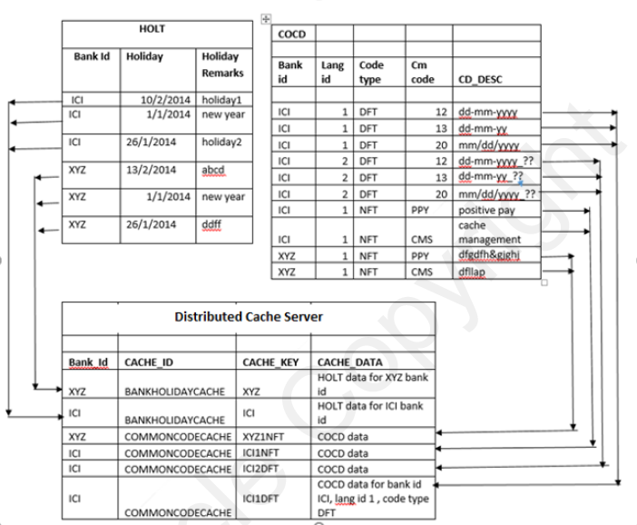
Caching - Redis
Dynamic Caching Framework is an interface in DEH. Redis Distributed Cache.
Notes:
PRPM, COCD MENUTREE

Slide 17
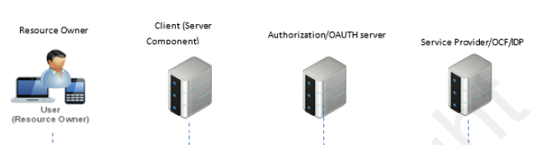
Open Authentication – oAuth 2.0
REST Based Business Services are exposed by the DEH over HTTP protocol. The services can be accessed over varied clients. To manage the access of these services we have used OAUTH authorization server.
OAUTH 2.0 framework has well defined flows which can distinguish trusted/third party application which can claim access to DEH services.

Slide 18
Type System
Using Type System framework all data structures, business entities are defined as types. These entities are well-defined objects with structural and behavioural consistency across the layers of DEH Platform.
Constraints and Validations can be set for each type
Categories :-
Primitives (Integer, Char, String, Float, Double, Long)
Lists
Entity References
Value Objects

Slide 19
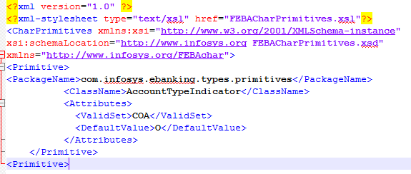
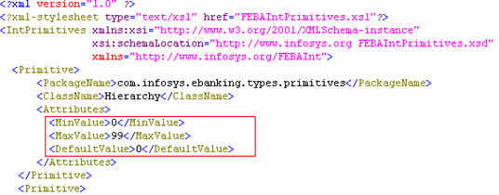
Primitives – Integer & Char

Slide 20
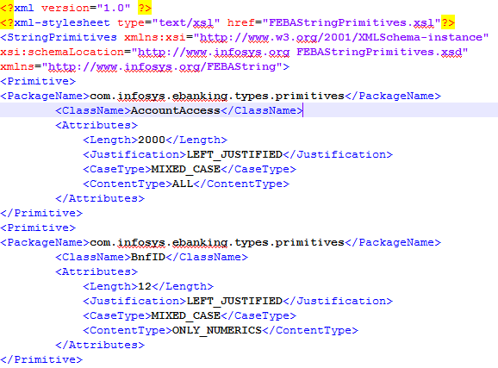
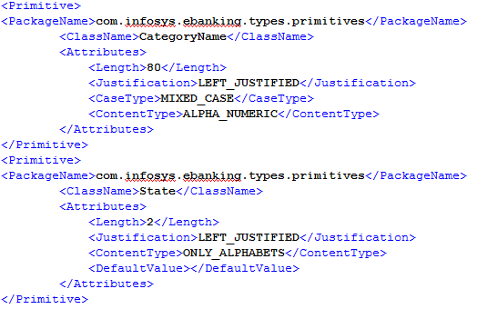
Primitives - String

Slide 21
List
List types hold listed collections of data elements.
IFEBAList classifies the list types.
Currently there are the following specific types under lists
FEBAArrayList - which represents an array-list of a data elements of a given feba type. It provides index-based access to its elements.
FEBAHashList - which represents both an array-list and a hash-map simultaneously, of data elements of a given feba type. It provides both key and index-based access to its elements.
Notes:
Array List: [A, B, C, D]
HashMap: {1=A, 2=B, 3=C, 4=D}

Slide 22
Value Objects
Represents all data elements of a business entity
Used to store and transfer data from one layer to another
Can contain :-
Primitives
Lists
Other value objects
Notes:
Notes GG

Slide 23
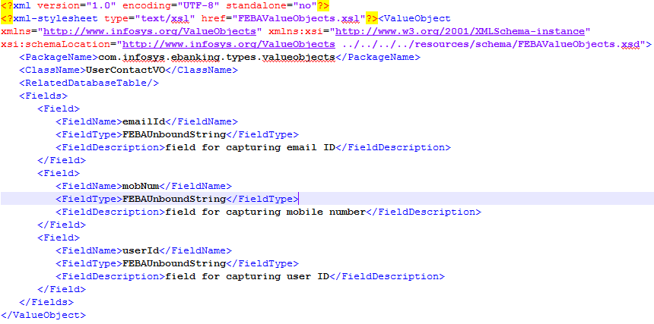
Value Objects - Example

Slide 24
Logging – Apache log4j
Debug
Confirmation
Message
Error
Fatal
Performance
Setup
Notes:
LogConfig

Slide 25
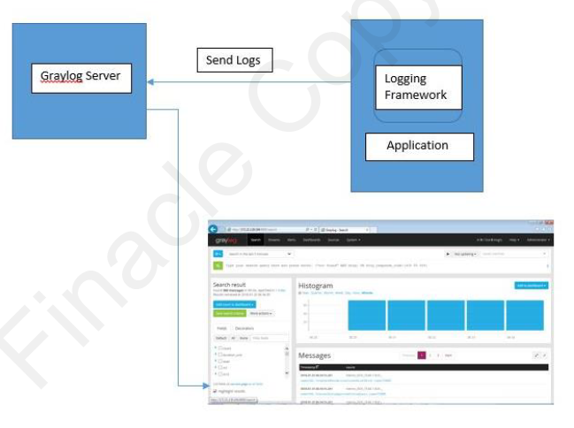
Graylog
Graylog has the capability of data visualization, automatic cleanup, user and role based access to log the application data.

Slide 26
THANK YOU
www.infosys.com/finacle
The contents of this document are proprietary and confidential to Infosys Limited and may not be disclosed in whole or in part at any time, to any third party without the prior written consent of Infosys Limited.
© 2012 Infosys Limited. All rights reserved. Copyright in the whole and any part of this document belongs to Infosys Limited. This work may not be used, sold, transferred, adapted, abridged, copied or reproduced in whole or in part, in any manner or form, or in any media, without the prior written consent of Infosys Limited.

